Slide 2
Development of A Parametric Tool for Automated Slot Insulation Insertion in Small-Scale Electric- Motor Stator Production
Alen Sebastian 23221507 (M Sc Electromobility)
Project Thesis Presentation

Slide 3
Table of Contents
Motivation and objectives
Fundamentals of Electric Motor Manufacture
Slot-Liner Function and Importance
Insertion of Slot Liners in Large Scale Manufacture
Insertion of Slot Liners in Small Scale manufacture
Proposed Automation Plan
Hardware Setup
Parametric Tool Development
Insertion Pipeline
Testing and Validation
Conclusion and Outlook

Slide 4
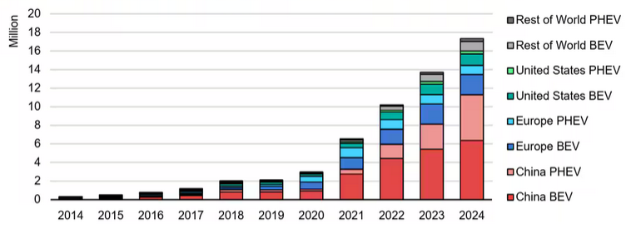
Motivation:
Climate change & CO₂ emissions → need for sustainable technologies
Transport sector accounts for about 23% of global CO2 emissions
Electrification trend → rapid growth of EVs →surge in electric motor demand
Large-scale production: highly automated
Small-scale/custom production: still manual, especially slot liner insertion
Manual process = time-consuming, inconsistent, costly
Fig 1: Global EV sales [1]

Slide 5
Objective: Develop a flexible insertion tool to automate slot-liner insertion in small-scale stator manufacturing
Automated Slot-Liner Insertion
Parametric Tool Design
Flexible manufacturing
Robotic Integration and validation
Process reliability and repeatability

Slide 6
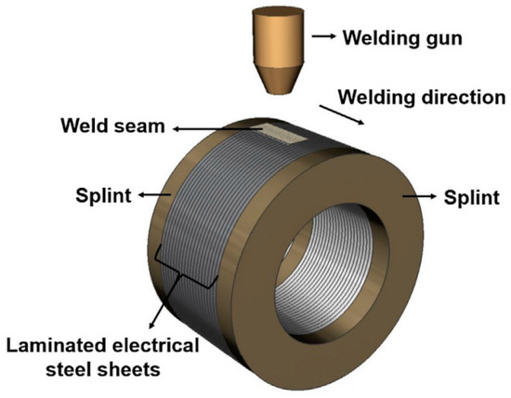
Overview of Motor Manufacturing Process: From Lamination Stack to finished Stator.

Slide 7
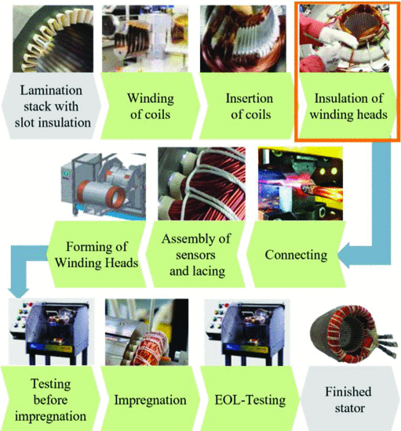

Slide 8
Slot Liner Function and Importance
Electrical Insulation – Prevents short circuits between windings and stator core.
Thermal Management – Supports heat dissipation from windings to the core.
Material Selection – Must balance high dielectric strength with sufficient thermal conductivity.
Precision Requirement – Manual insertion is error-prone and inconsistent, making automation essential.

Slide 9
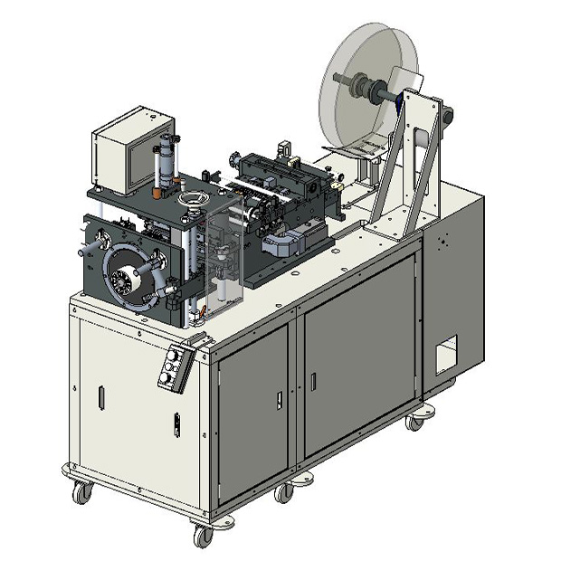
Slot-Liner Insertion In Large Scale Manufacture
Fully Automated Machines – e.g., ELMOTEC STATOMAT, NIDE, GMW.
Process – Creasing, folding, cutting, and inserting slot liners with high precision
Performance – High speed (up to 3 sleeves/sec) and consistent quality.
Advanced Features – Servo-driven feeding, programmable interfaces, robotic loading/unloading.
Advantages – Precision, repeatability, durability, minimal user effort.
Limitation – High investment cost, optimized for large batches → less viable for low-volume, high-variance production.
Figure 5‑1: GMW CS-5E Horizontal Slot Cell Inserter [53]

Slide 10
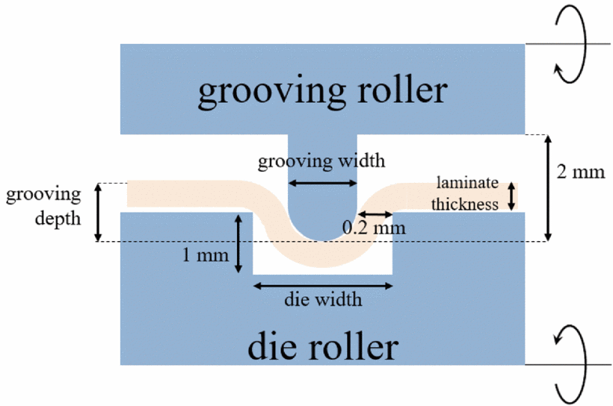
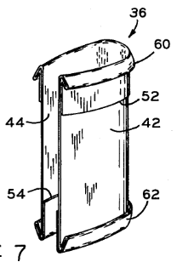
Slot-Liner Insertion in Small Scale Manufacture
Predominantly Manual Process – Operators cut, fold, and insert slot liners by hand.
Simple Tools – Use of jigs, cutting/folding machines; insertion done manually.
Design Adaptations – Special slot liners with folded or cuffed ends for easier manual handling.
Advantages – Flexible, low-cost, suitable for small volumes.
Limitations – Labour-intensive, inconsistent quality, difficult to scale or standardize, limited integration with digital workflows.

Slide 11
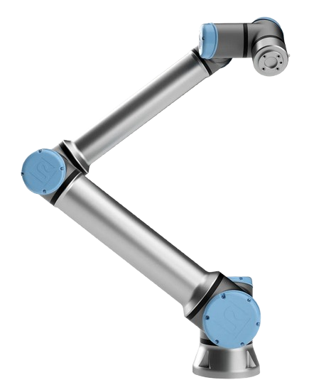
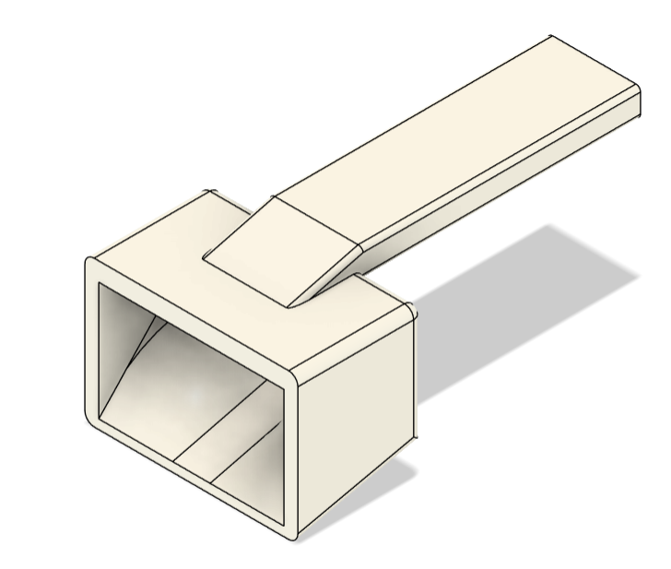
Proposed Automation Plan
Goal: Automate slot liner insertion for small-scale, high-variant motor production.
Approach:
Develop a parametric tool adaptable to different stator sizes and shapes.
Integrate with a collaborative robot setup (UR10e, gripper, FT sensor).
Workflow Concept:
Slot liner positioning
Orientation with funnel/clamp system
Automated insertion with robotic guidance
Expected Benefits:
Increased precision and repeatability
Reduced labor intensity and errors
Flexibility for small-batch, high-variance manufacturing

Slide 12
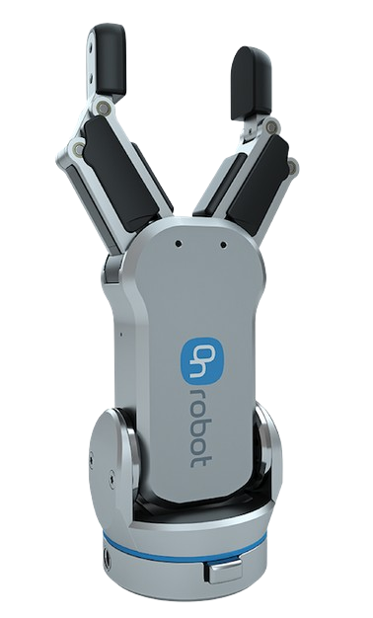
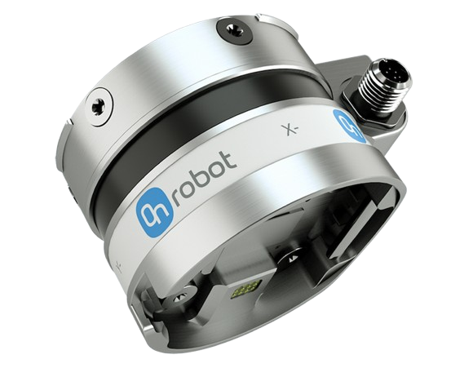
Hardware Components for Automated Insertion: UR10e Collaborative Robot, RG2 Gripper, and Force/Torque Sensor
UR10e Cobot:
Provides precise programmable motion 12.5 kg payload 1300 mm reach compact and safe Easily adaptable for flexible manufacturing
RG2 Gripper:
Adjustable 2 finger gripper 110 mm stroke length Intelligent grip detection Customizable fingertips Suitable for secure handling of Slot Liners
HEX Force-Torque Sensor:
Real-time force monitoring 6 axis Force Torque measurement Ensures accurate insertion of liner Misalignment detection Configurable force thresholds

Slide 13
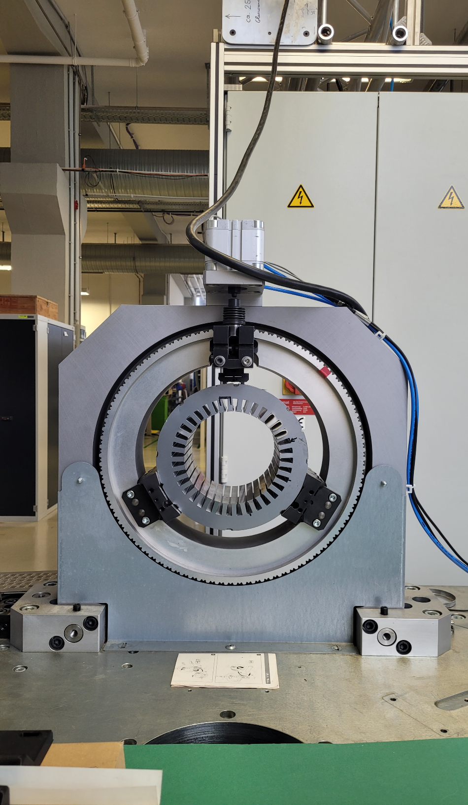
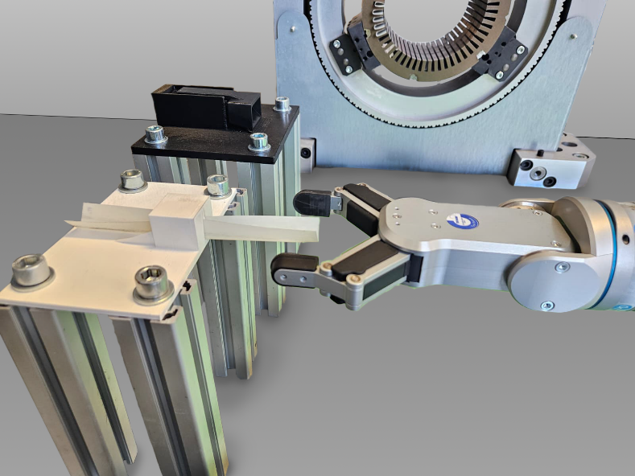
Mechanical Fixtures for Accurate Positioning of Stator, Slot Liner, and Funnel
Rotating Mechanical Clamp
1). User-defined rotation aligns each slot with the funnel for fully automatic insertions. 2). Servo Motor + Siemens S7-1500 PLC - Provides precise, deterministic low-level motion control. 3). Manual origin calibration, stop-rotation function for safety, collision avoidance, and adaptability
Rotating Mechanical Clamp
Slot Liner and Funnel Positioning Platforms
1). Secure, repeatable positioning for insertion tool and slot liners 2). Quickly accommodates different stator or slot liner geometries with minimal downtime. 3). Ensures accurate robot grasping, reducing misalignment and improving repeatability. 4). Enhances workflow efficiency in small-batch or high-mix production while maintaining precision.

Slide 14
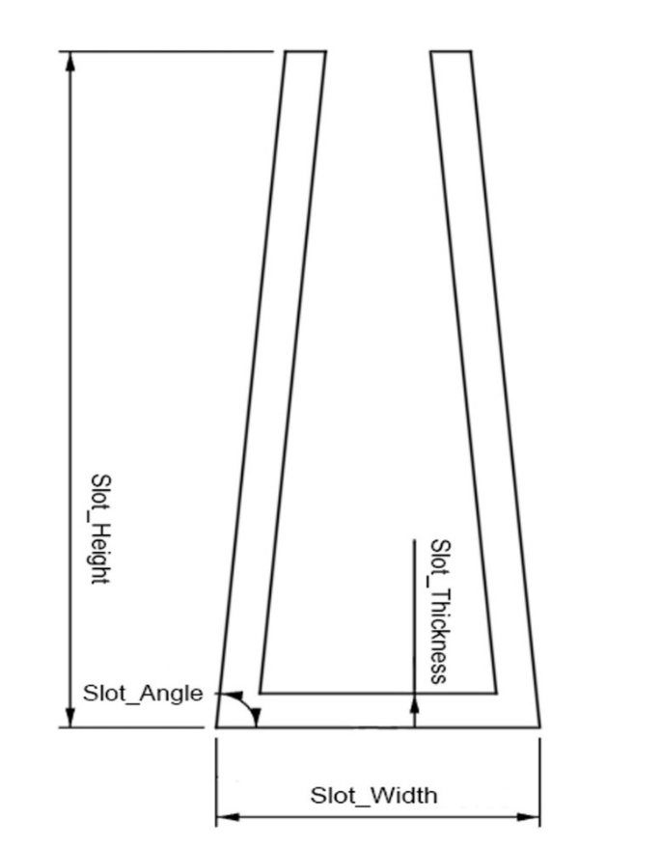
Parametric Tool Development
Design Considerations

Slide 15
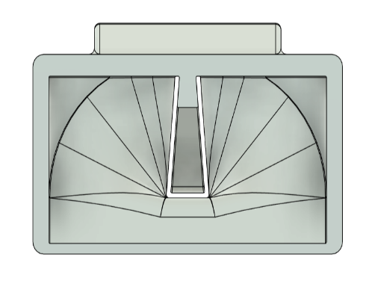
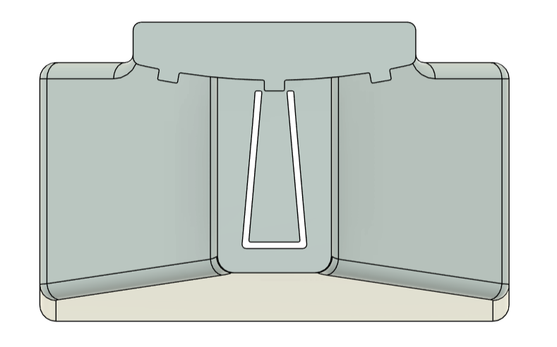
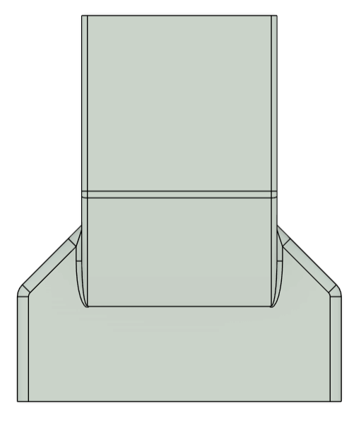
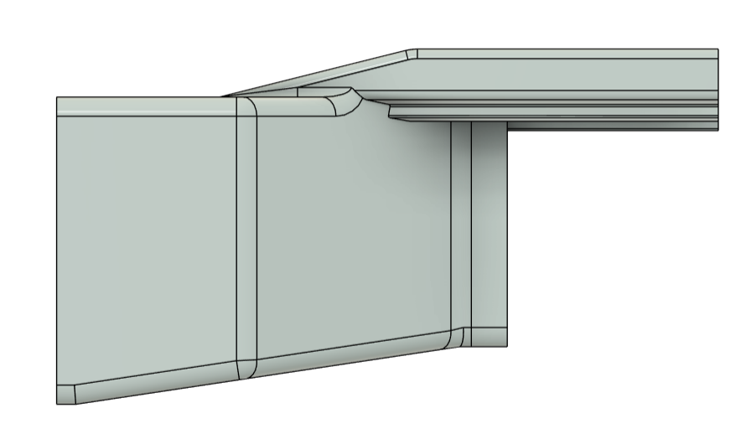
Initial Design
a) Front view
b) Rear view
c) Side view
d) Top view

Slide 16
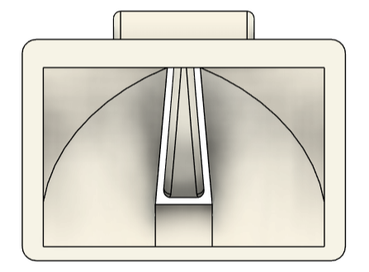
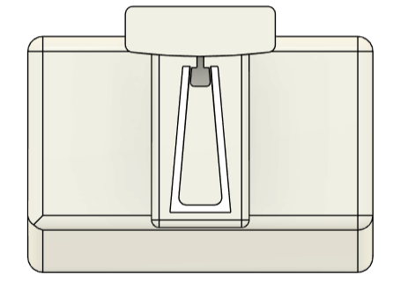
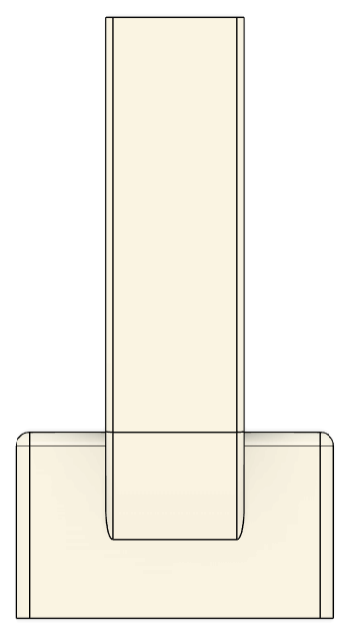
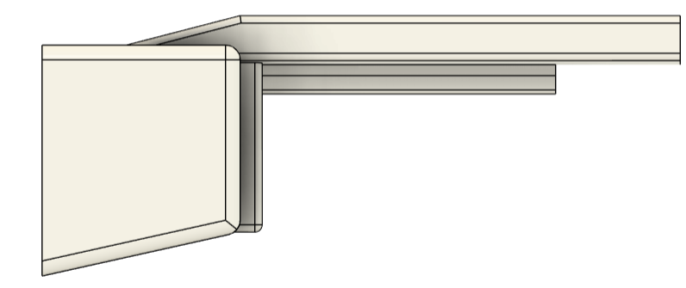
Final Design
a) Front view
b) Rear view
c) Top view
d) Side view
e) Isometric view

Slide 17
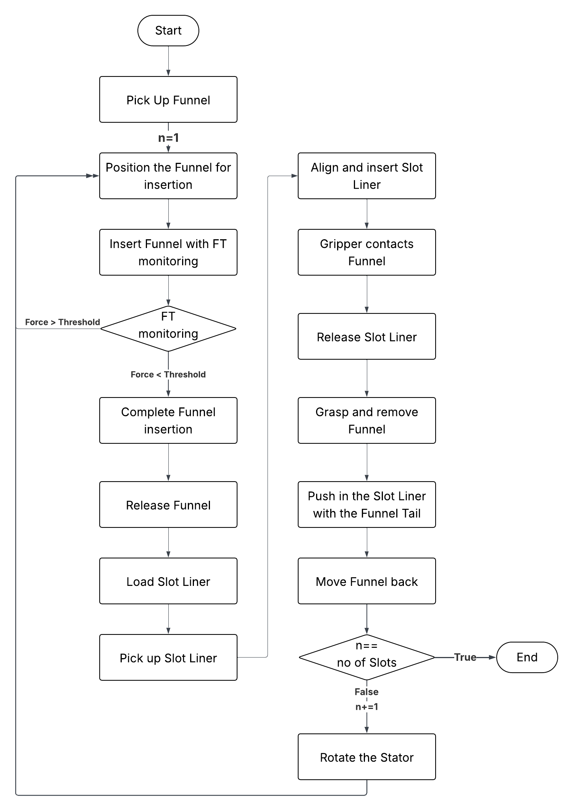
Insertion Pipeline

Slide 18
Validation
3 different Stators and 3 Funnels

Slide 19
Testing Results

Slide 20
Error Rates

Slide 21
[1] IEA (2025), Global electric car sales, 2014-2024, IEA, Paris
https://www.iea.org/data-and-statistics/charts/global-electric-car-sales-2014-2024, Licence: CC BY 4.0
Joining of the Laminated Electrical Steels in Motor Manufacturing: A Review

Slide 22
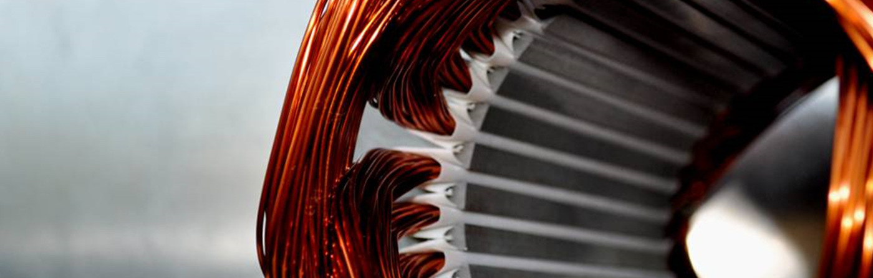

Slide 23
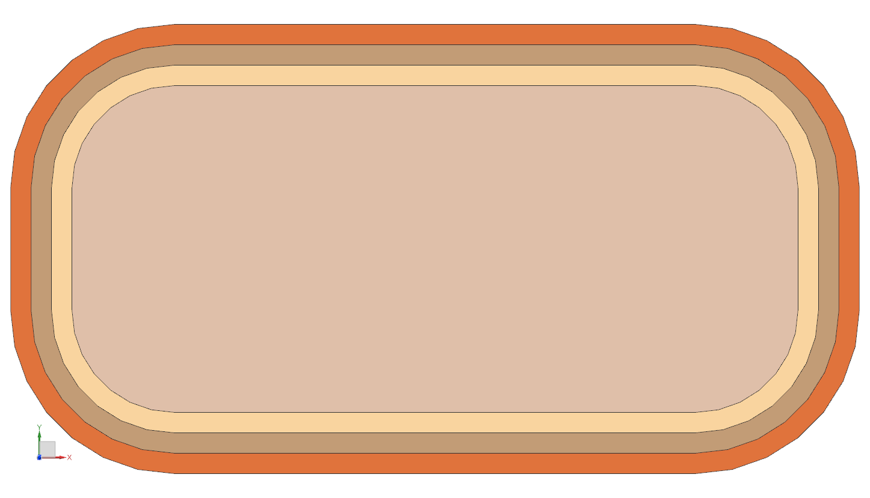
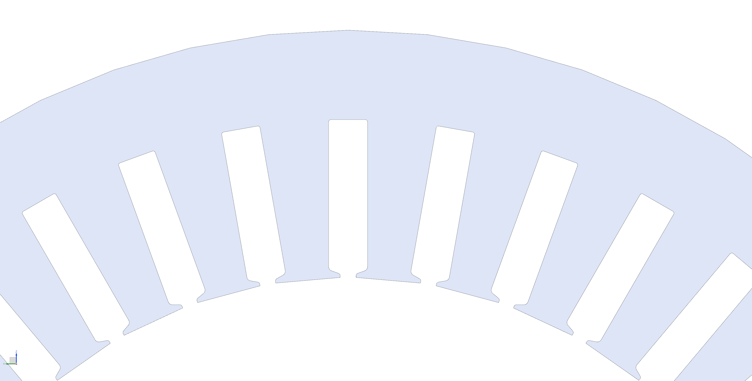

Linien etc
Trägermaterial (Kupfer)
4,4
4
1
1
1
5
2
3
Projektvergleich starten
Projektvergleich starten
D
$$I$$
16,3
wicklungstyp = 1
B
Leistungsteil Induktionsanlage
Anvil
1 A bei 50 Hz
Leitermaß
3,65
Außenmaß
1 A bei 50 Hz
Switch on/off control voltage
3,55
Gegenwerkzeug zur Fixierung und Ausrichtung der Einzelbleche
Kühleinheit Induktionsanlage
Anvil

